Slide 1


What is a Chi-squared Test? It is a test used to determine the relationship between two categorical variables. A categorical variable is qualitative data. **Nominal - Marital Status, Gender **Ordinal - Age, Level Of Education

Slide 2
Hypothesis testing
Hypothesis testing is a technique for interpreting and drawing inferences about a population based on sample data.
Null Hypothesis: The null hypothesis is the assumption that the event will not occur.
Alternate Hypothesis: The acceptance of the alternative hypothesis follows the rejection of the null hypothesis.
Alpha value - the threshold for statistical significance. That is, the probability of rejecting the null hypothesis when the null hypothesis is true. Usually assumed to be 0.05

Slide 3
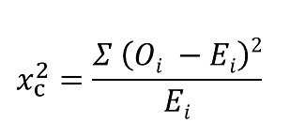
Formula
X**2 - chi-squared value
C - degree of freedom = (r-1)(c-1)
O - observed frequency
E - expected frequency

Slide 4
ASSUMPTIONS OF CHI-SQUARE TEST
You are comparing two categorical variables
-They should not be decimals or fractions but whole numbers. Things that have frequencies
-They should not be decimals or fractions but whole numbers. Things that have frequencies
-level/categories are mutually exclusive
Randomly drawn sample from the population
- should not be skewed
The expected cell frequency of each cell should be greater than 5 for most of the cells at least 80%.

Slide 5
Continuation of chi-square test
The chi-square test is a hypothesis test that is used when you want to determine whether there is a relationship between two categorical variables. Example of categorical variables, Gender (Male and Female).
Marital status | Middle school | High school | Bachelor | Master’s | PhD | Total
Single | 18 | 36 | 21 | 9 | 6 | 90
Married | 12 | 36 | 45 | 36 | 21 | 150
Divorced | 6 | 9 | 9 | 6 | 3 | 30
Widowed | 3 | 9 | 9 | 6 | 3 | 30
Total | 39 | 90 | 84 | 54 | 33 | 300
Observation values

Slide 6
Continuation of chi-square test
Marital status | Middle school | High school | Bachelor | Master’s | PhD
Single | 11.7 | 27 | 25.2 | 16.2 | 9.9
Married | 19.5 | 45 | 42 | 27 | 16.5
Divorced | 3.9 | 9 | 8.4 | 5.4 | 3.3
Widowed | 3.9 | 9 | 8.4 | 5.4 | 3.3
Expected values

Slide 7
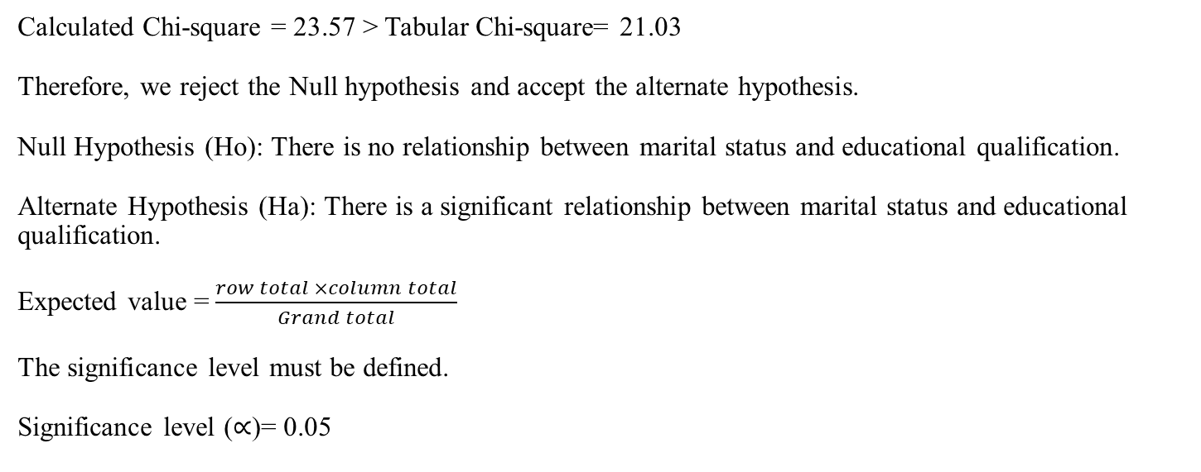
Chi-square TEST
Calculated Chi-square = 23.57 > Tabular Chi-square= 21.03
Therefore, we reject the Null hypothesis and accept the alternate hypothesis.
Null Hypothesis (Ho): There is no relationship between marital status and educational qualification.
Alternate Hypothesis (Ha): There is a significant relationship between marital status and educational qualification.
Expected value =$\frac{row total ×column total}{Grand total}$
The significance level must be defined.
Significance level ($∝$)= 0.05

Slide 8
PYTHON CODE
from scipy.stats import chi2_contingency
#defining the table
data = [[207, 282, 241], [234, 242, 232]]
stat, p, dof, expected = chi2_contingency(data)
#interpret p-value
alpha = 0.05
print (“p-value is " + str(p))if p <= alpha:
print('Dependent (reject H0)’)
else:
print('Independent (H0 holds true)')

Slide 9
EXPLANATION
The Contingency table (also called crosstab) is used in statistics to summarise the relationship between several categorical variables.
A null Hypothesis is a general statistical statement or assumption about a population parameter that is assumed to be true Until we have sufficient evidence to reject it.
It is generally denoted by Ho.
The Alternate Hypothesis is considered as competing of the null hypothesis. It is generally denoted by H1. The general goal of our hypothesis testing is to test the Alternative hypothesis against the null hypothesis.
A P-value is used as a measure of evidence against the null hypothesis. If it is greater than our level of significance then we will accept our null hypothesis.

Slide 10
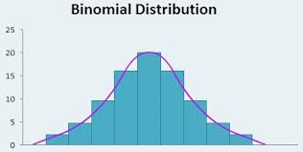
BINOMIAL DISTRIBUTION
Binomial distribution is a discrete probability distribution that describes the number of successes in a fixed number of independent Bernoulli trials, where each trial has two possible outcomes—success or failure.

Slide 11
EXAMPLES OF BINOMIAL DISTRIBUTION
1)Political elections-Modelling the probability of a candidate winning(success)or losing(failure) in a series of elections
2)Sports Outcomes-when analyzing sports events with binary outcomes(win/lose). The binomial distribution can model the number of wins in a series of games.
3)loan approvals-In banking, the binomial distribution can be applied to model the probability of a loan application being approved (success)/rejected (failure)

Slide 12
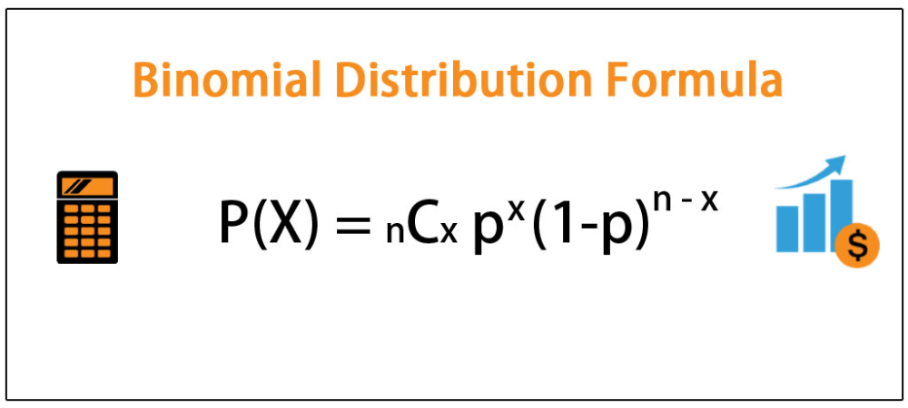
FORMULA
Where:
n is the number of trials (occurrences)
x is the number of successful trials
p is the probability of success in a single trial
^{n} C _{x} is the combination of n and x.

Slide 13
THANK YOU.
END OF PRESENTATION

